Slide 1
Easy Drawer Maker
Please Note: The version 3.0 has been patched to support Vectric 11.0 release.
After Vectric Engineers make the new SDK available a new version will be provided that fully supports version 11's capabilities with multi-sheet layouts.

Slide 2
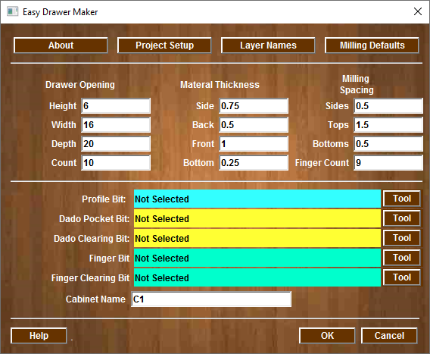
Main Screen
About Gadget
Default Settings
Drawer Opening Size
Milling Settings
Toolpaths will be added if you select tooling
Enter Cabinet Name (BOM)

Slide 3
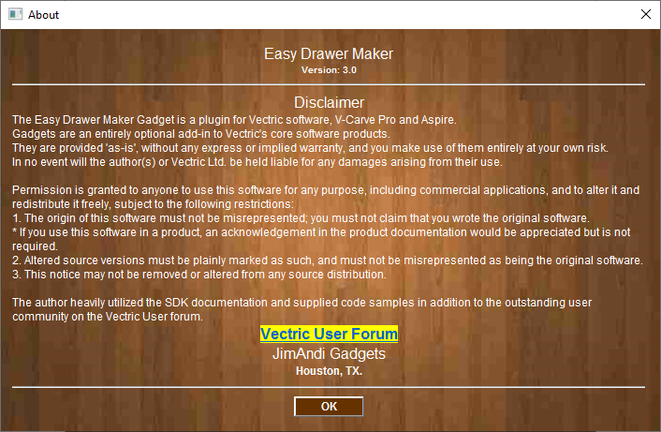
About Screen

Slide 4
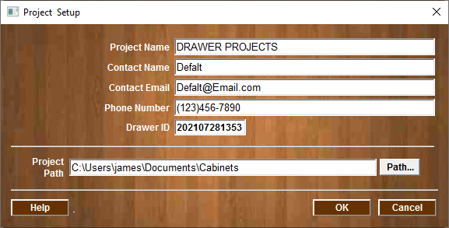
Project Setup Menu
Enter the Project
And
Contact Information
Project Path is required. All logs and BOM will be written

Slide 5
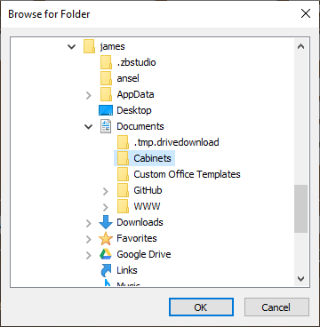
Project Path Setup
Enter the Project
And
Contact Information
Project Path is required. All logs and BOM will be written

Slide 6
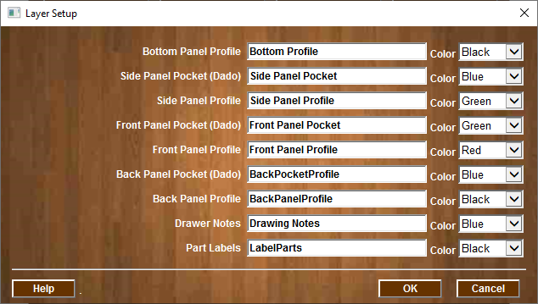
Layer Setup
Layer Name for each milling operation
Layer Colors

Slide 7
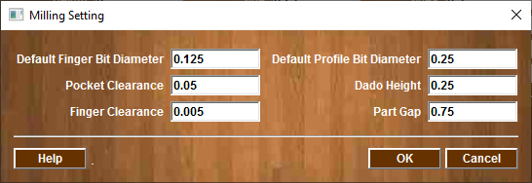
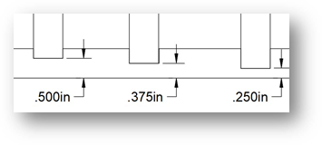
Milling Settings Menu
Default values for Milling
Note: Back Dado Height and Dado Height are measurements from the material back to the bottom of the Dado. Sheet goods very in thickness, a 3/4” plywood is never 3/4” it is usually 23/32” thick or less. This will ensure the overall dimensions of the cabinet will be accurate regardless of thickness of the material being used.
Dado Height Value
Material Back/Bottom

Slide 8
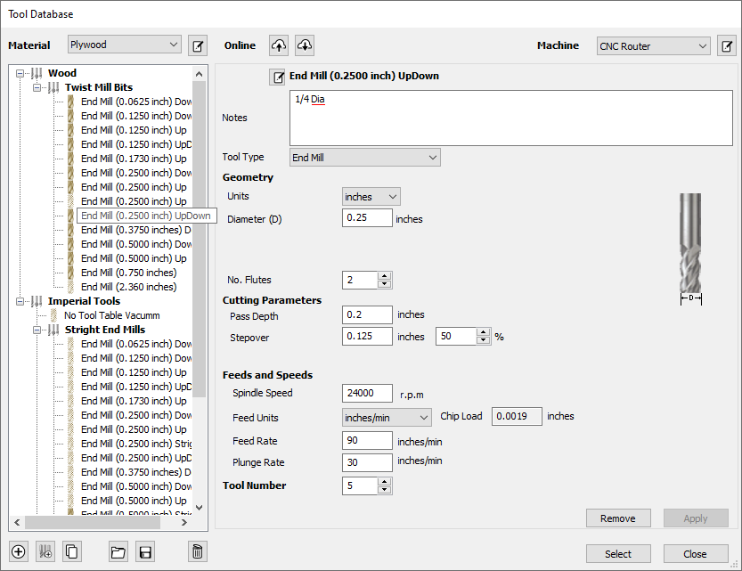
Tool Selection for Part Profile

Slide 9
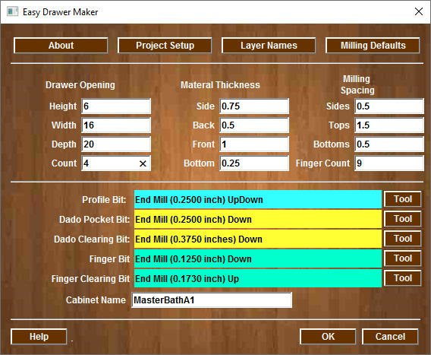
Wall Cabinet Layout
Drawing (4) Drawers
Toolpaths will be added
Select OK to build Drawers

Slide 10
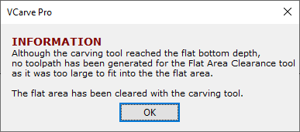
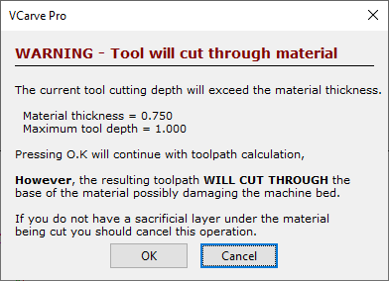
Alerts and Warnings
Press OK and let the gadget complete
Note: Alert and Warning Windows “may” be displayed. This is due to issues with automation of toolpath creation. This Gadget cannot foresee all issues with milling (Depth of Cut, Clearing values, and/or Bit selection issues).
The user must validate all aspects of the milling operation.

Slide 11
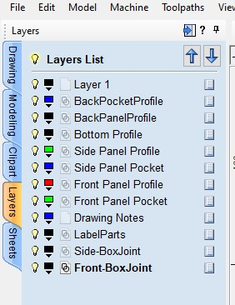
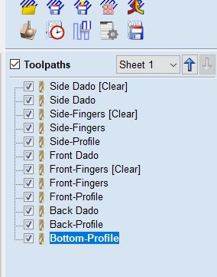
Layers and Toolpaths
Due to API issues with Version 11.0 the Drawing notes are not used. Works with earlier Versions

Slide 12
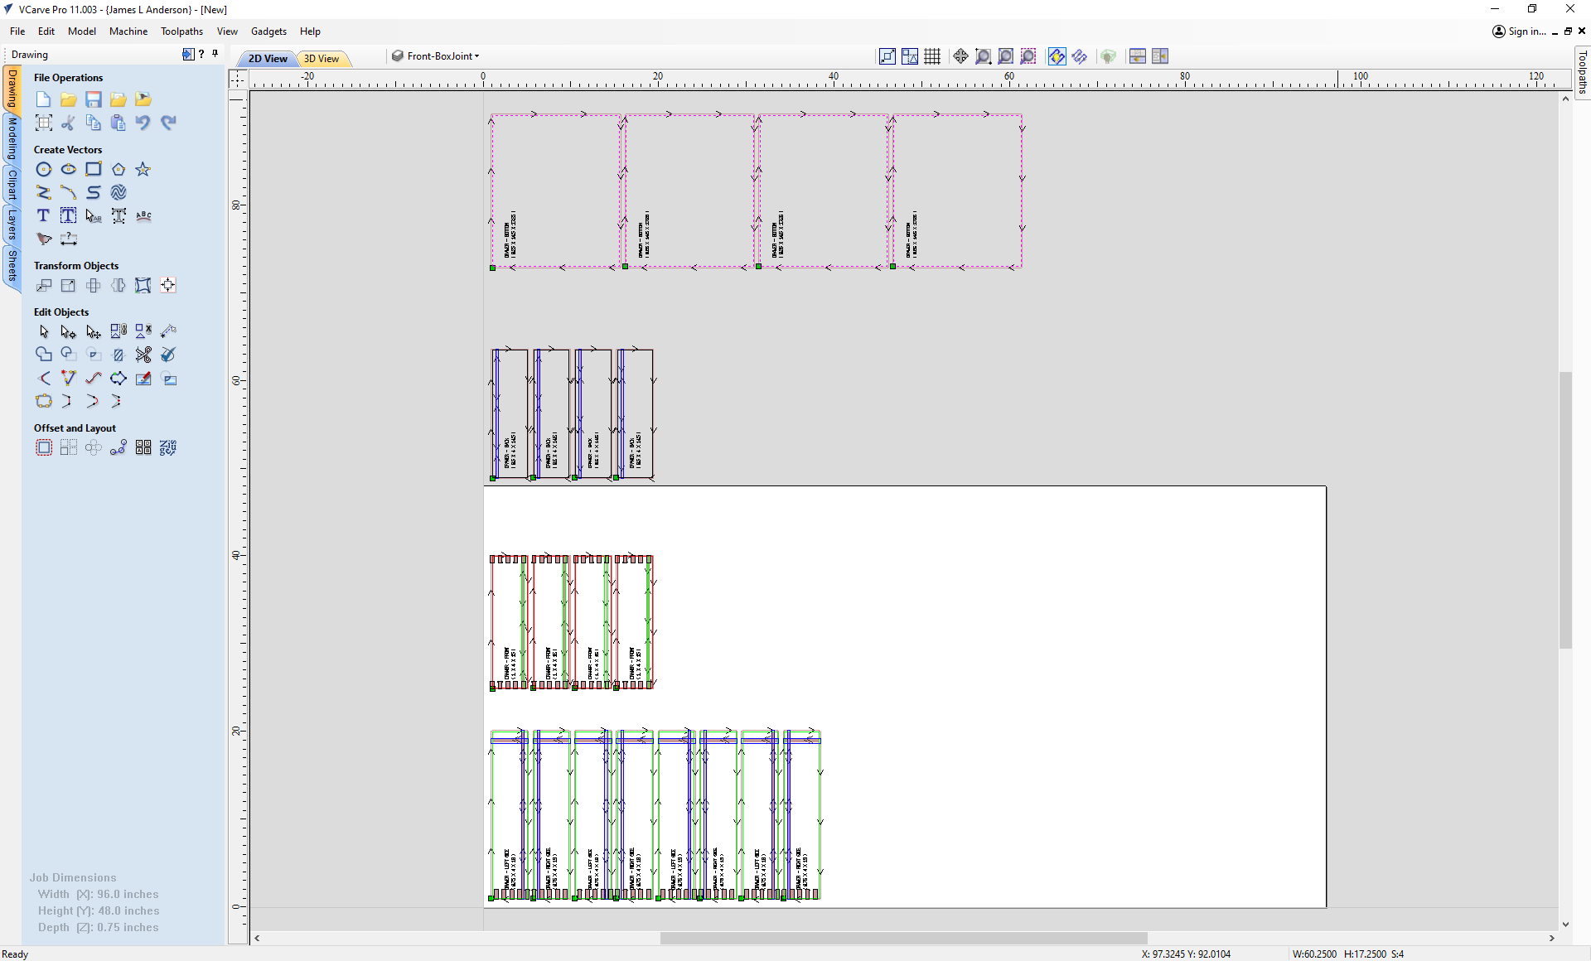
Vectric 11 Drawing Layout

Slide 13
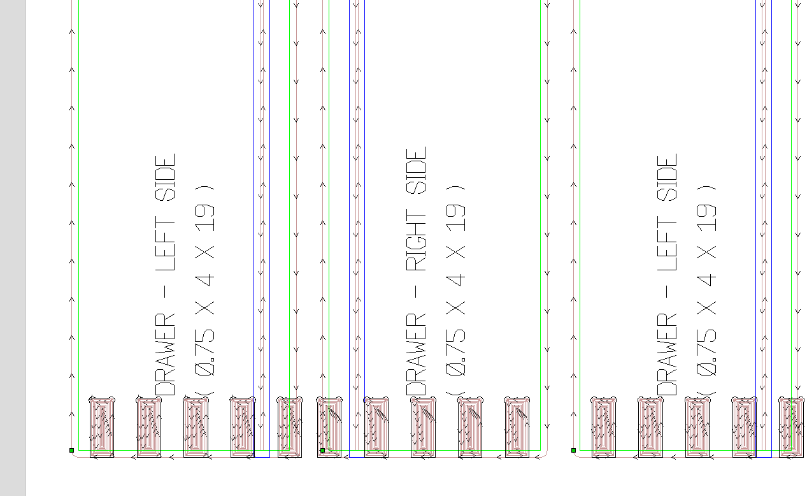
Part Notation
Each Part is labeled with
Where it is used, Thickness, Length, and Width

Slide 14
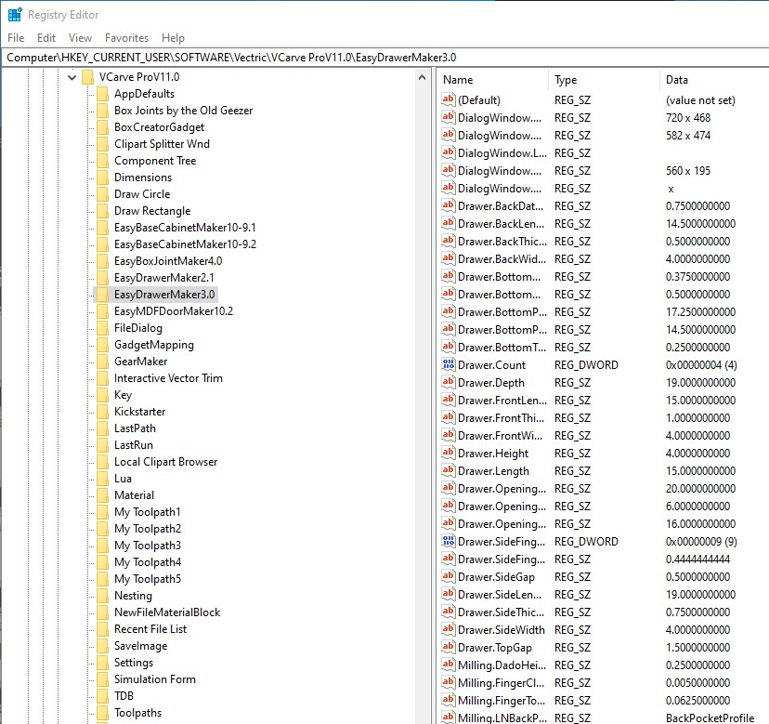
Registry Data
All data is stored in the system registry and can be accessed using the Microsoft Regedit tool

Slide 15
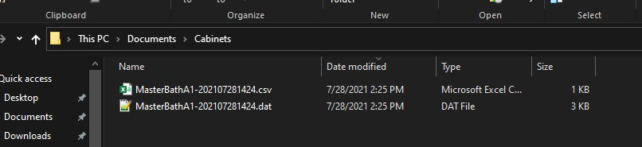
Bill of Material Files

Slide 16
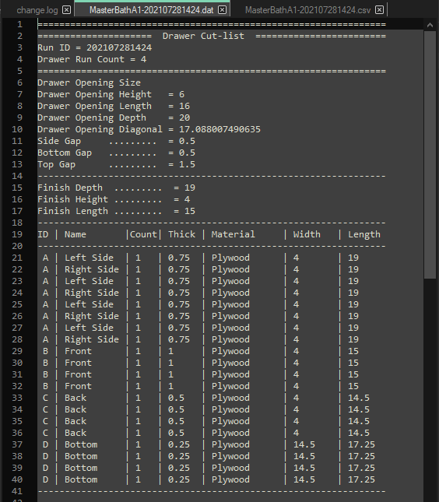
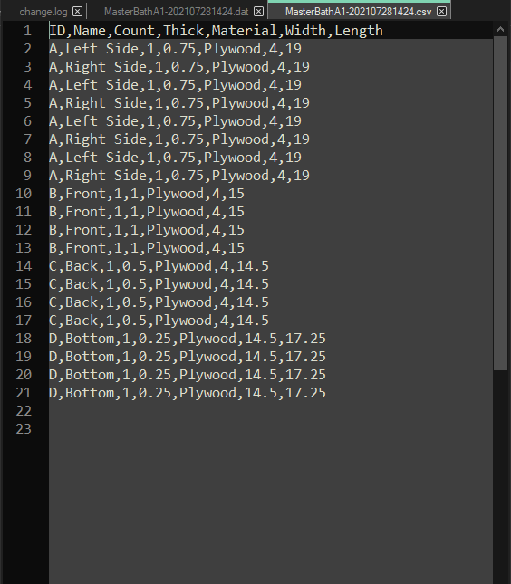
Edit CSV file in Excel or Text editor

